Slide 1
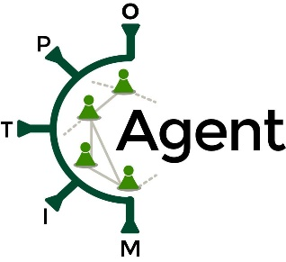
Narrative review of infectious disease spread models developed in Poland during COVID-19 pandemic
Andrzej Jarynowski, Vitaly Belik
1) System Modeling Group, Institute of Veterinary Epidemiology and Biostatistics, Freie Universität Berlin, Germany
2) Interdisciplinary Research Institute, Głogów, Aidmed, Gdańsk/ Polish Hygienic Association, Lower Silesia District, Poland
Wrocław, 14.09.2023

Slide 2
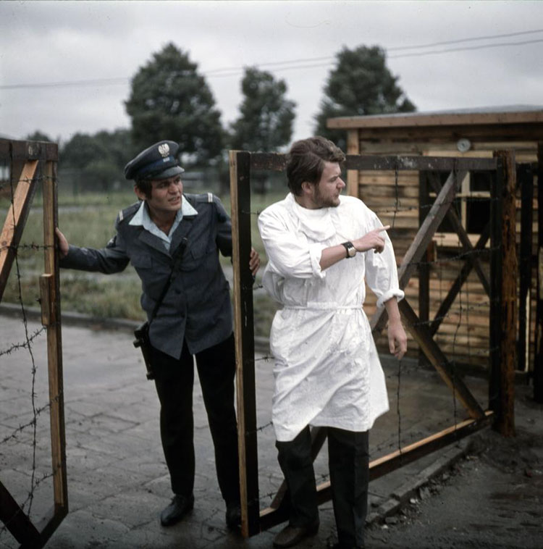
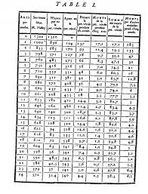
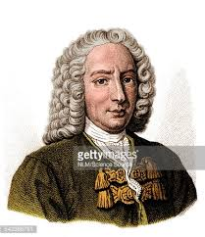
I simply wish that, in a matter which so closely concerns the well-being of mankind, no decision shall be made without all the knowledge which a little analysis and calculation can provide.
Daniel Bernoulli, presenting
his estimates of smallpox
Royal Academy of Sciences,
Paris, 30 April 1760
In Europe smallpox last time appeared in Wroclaw in 1963, but it was stopped by the actions of the government and epidemiologists. Moreover smallpox was eradicated by WHO in 1979. Bernoulli (1760) actually used date provided from Wroclaw to estimate his model.

Slide 3
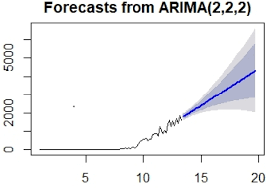
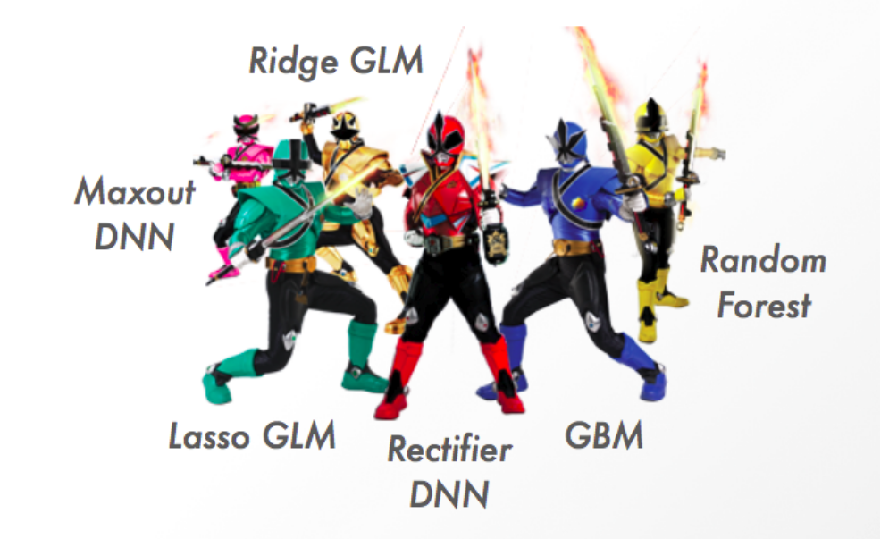
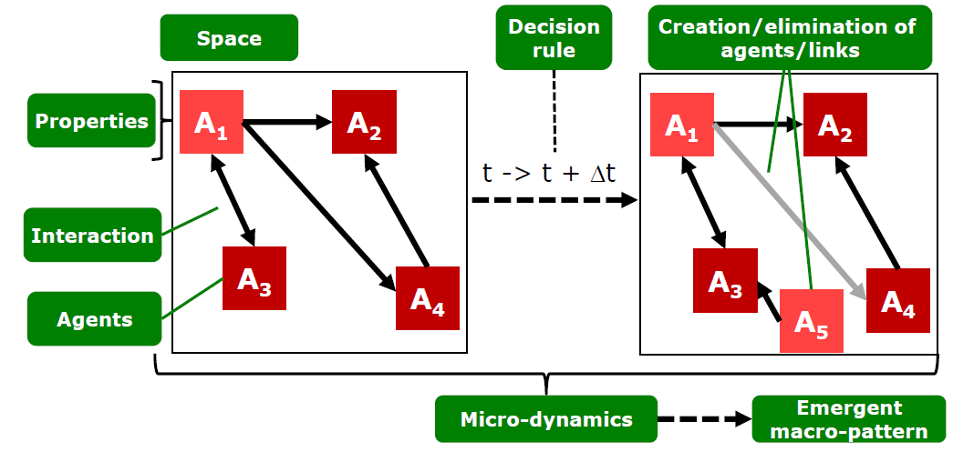
S
I
R
Susceptible (S), Infectious (I), Removed (R)
Agent-based models (ABM)
????

Slide 4
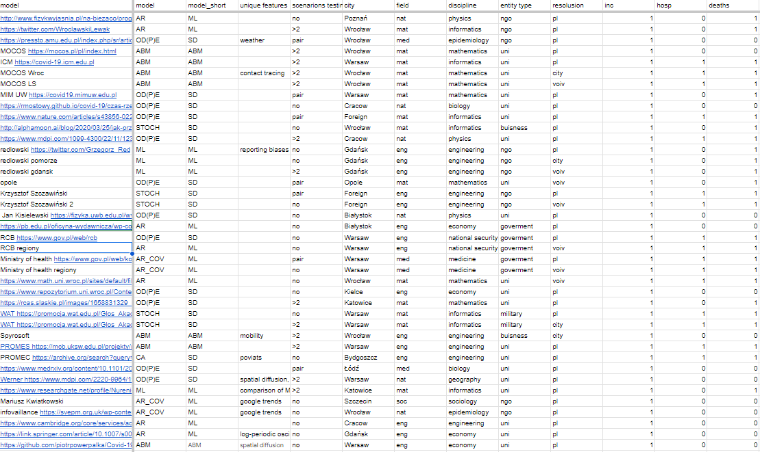
https://docs.google.com/spreadsheets/d/1125HWV1Fh38XcQ8epSW0S07rIf6KpN6wiEzFgIu5IA4/edit?usp=sharing

Slide 5
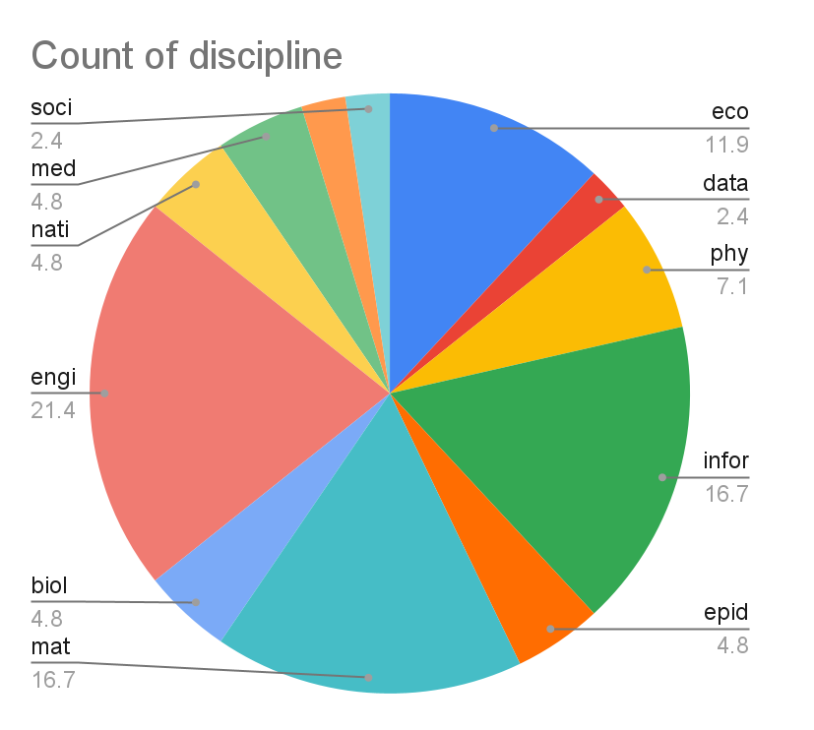
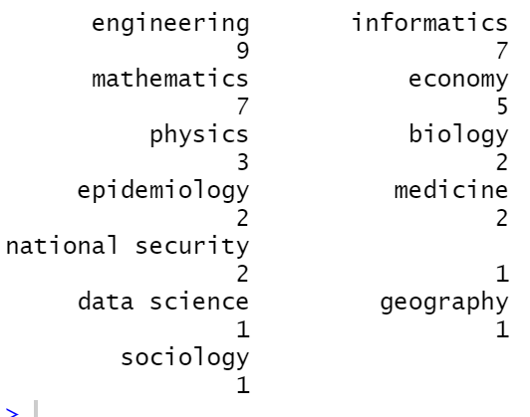
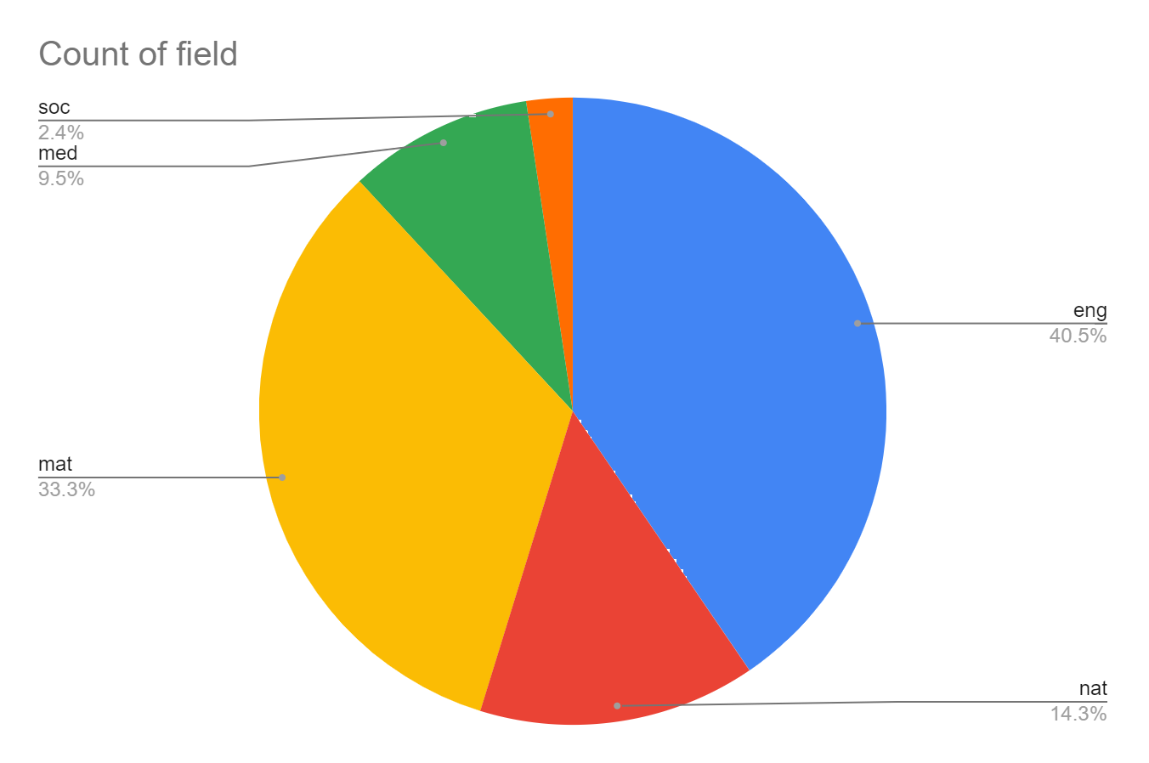

Slide 7
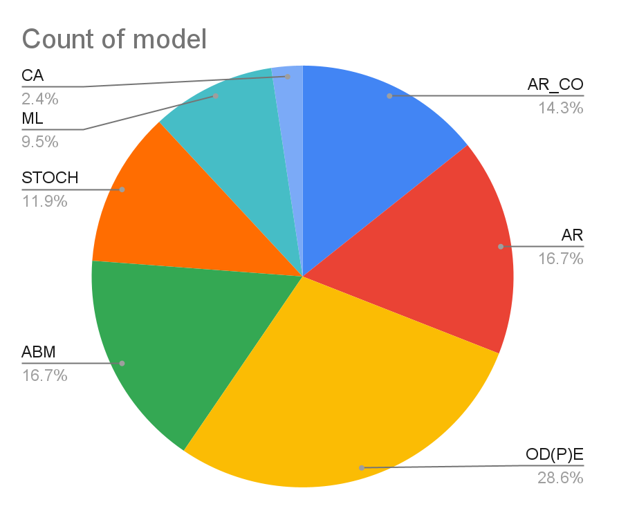
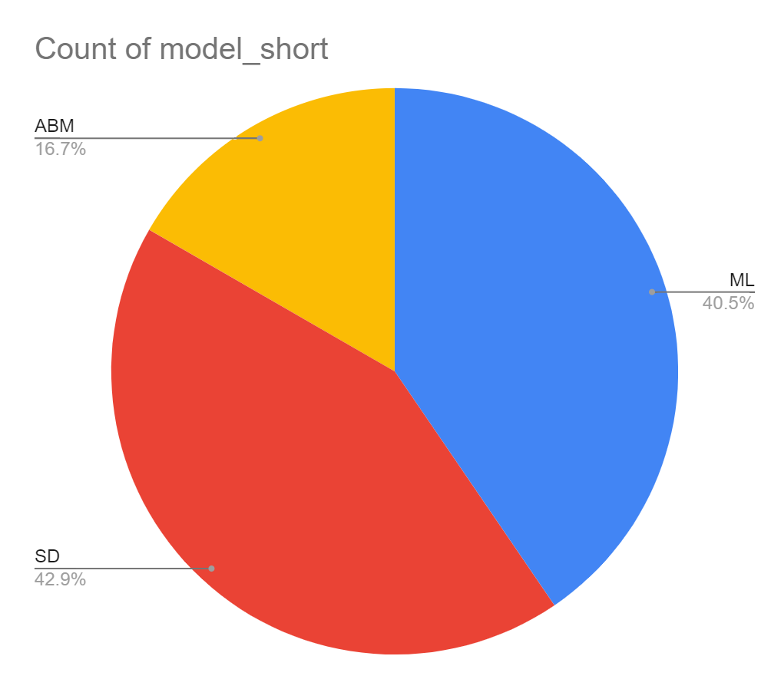
AR | Timer series (i.e. autoregression) of itself
AR_COV | Timer series (i.e. autoregression) with covariates
STOCH | stochastic model (i.e. branching process or probabilistic compartmental model)
OD(P)E | deterministic differential equations
ABM | Agent based model
CA | cellular automata
ML | Machine Learning model

Slide 8
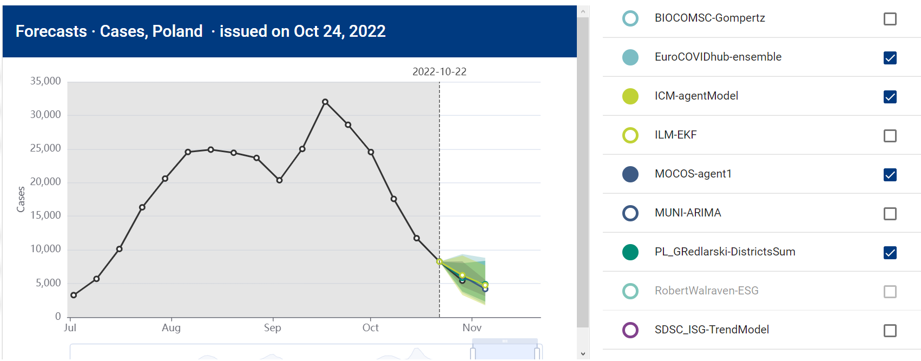
FORECASTING OF COVID-19
https://covid19forecasthub.eu/visualisation.html

Slide 9
Long-term prediction
?
System dynamics
Medium-term prediction
Agent based models
ICM-agentModel (next are close to it)
Short-term prediction
Machine learning
PL_GRedlarsk REl_wis 0.12 (next 0.36)

Slide 10
HPAI
ASF
COVID-19
PARASITES
Antimicrobial USE
Ecological disasters
contact networks | from vision (tracking), RFID | from vision, bluetooth | Human-minks interactions | from vision (tracking), RFID | - | -
Spatiotemporal patterns (covariates) | Wild birds, climate, poultry density , Weather seasonality | Pigs density, human mobility, Production seasonality. trade registries | Adherence to measures, causal models | Exposure to environment (prediction) | Weather seasonality | Satellite images
Early detection (sensors) | Mortality, eggs production, movements (vision), coughing (sound) | Mortality, movements (vision), | Coughing (sound analysis) | eggs production, movements, (time series) | - | biomonitoring
Infoveillence | - | - | Bug of words (demand and supply of information | - | discussion and search on AM | Discussion of group of interests
Infodemiology | Adherence to biosecurity, social tensions (NLP) | Adherence to biosecurity, social tensions (NLP) | Antisanitarian attitude | - | Perception of AM | Comparing discussion in Poland and Germany
http://interdisciplinary-research.eu/wp-content/uploads/2023/09/wroclaw_fens.pptx.pdf

